Slide 1
SYD466:
Software Analysis and Design – Part II
Lecture 1: Introduction
Key Reference: Systems Analysis and Design In a Changing World, 7th Edition, Satzinger, Jackson, Burd

Slide 2
Do you have the prerequisite?
SYD366
If you haven’t taken SYD366, then please contact your student advisior

Slide 3
The Role of the Systems Analyst
Development Process | Course Code
Understand the need (business need) | SYD466, PRJ566, PRJ666
Capture the vision | SYD466, PRJ566, PRJ666
Define the solution | SYD466, PRJ566, PRJ666
Communicate the vision and the solution | SYD466, PRJ566, PRJ666
Build the solution | PRJ566, PRJ666
Confirm the solution meets the need | PRJ566, PRJ666
Launch the solution application | PRJ566, PRJ666
*Chapter 1 – page 9

Slide 4
In SYD466
Review Advanced Design and Deployment Concepts
Introduction to System Development
Systems Analysis Tasks
Essentials of System Design
Problem – Business needs
Requests for Proposals
*Chapter 1 – page 9

Slide 5
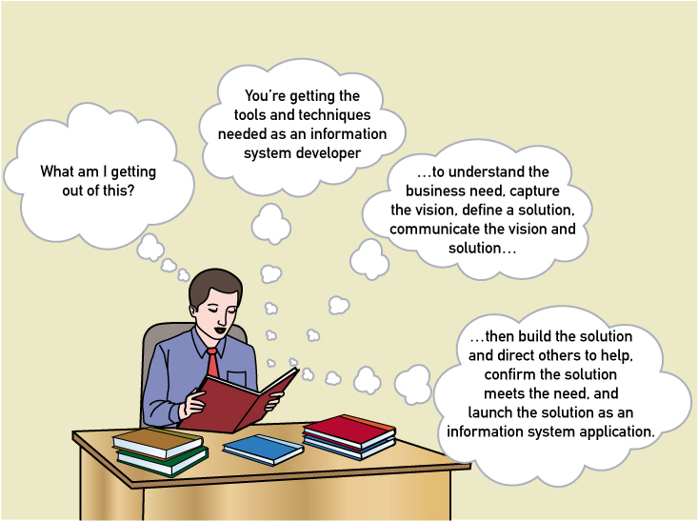
In SYD466
*Chapter 1 – figure 1-3

Slide 6
We worked on our Modelling skills in SYD366
Domain model
  Domain class diagrams: initial class definitions, attributes, relationships and multiplicity.
Design model
  Object level sequence diagrams
  Design class diagrams—design level classes (reference associations, interfaces, etc.)

Slide 7
SYD466
Frequently Asked Questions
Is SYD466 a modelling course? | Yes, in fact we are expanding on our knowledge of modelling from SYD366
Is SYD466 a business course? | Yes, you must understand business processes in order to propose solutions
Is SYD466 a technical writing course? | Yes, you must be able to describe communications between the system and the user in clear technical English
Is SYD466 a research course? | Yes, you must be able to research topics that you are not an expert in.
Will I be given the answers? | No. In systems there are many correct answers so we would never impose our solutions on you.
Is SYD466 a communications course? | Yes, students who ask questions do well.

Slide 8
What are we doing in our SYD Courses?
Repeat from
SYD366
Focusing
on
Analysis
Design
Implementation
Testing
Evaluation

Slide 9


What did we do in SYD366?
Blue: provided
Purple: your work
Gather
Requirements
Use Case Scenarios
Sequence Diagrams
Problem Definition
Use Case Development
Class Diagram

Slide 10
What are we doing in SYD466?
Blue: provided
Purple: your work
Gather
Requirements
Sequence Diagrams
Problem Definition
Use Case Scenarios
Use Case Development
Class Diagram
UI Design
Activity Diagram

Slide 11
Our Intent
Provide students with the building blocks required to work effectively using SDLC
For a comprehensive overview, please read the required textbook for SYD466
Systems Analysis and Design in a Changing World by John Satzinger, Robert Jackson, and Stephen D.Burd,
Cengage Learning, ISBN 978-1-305-11720-4

Slide 12
So let’s look at the Advanced Concepts of Composition and Generalization

Slide 13
A Composition Relationship
Two classes are in a composition relationship if one contains the other. If the container class disappears, so does the contained or component class; or it might be put into another container. The contained class cannot exist outside the container.
One of the key reasons for using a composition in modeling is to simplify the model. You can model at the container class level instead of modeling at the more detailed component class level.

Slide 14
Example: Consider the relationship of an invoice to all of the items on the invoice. A hardware store invoice that totals $113 might contain 2 gallons of white ceiling paint at $30 each, and one gallon of high coverage primer at $40. The invoice might look like this:
Hardware Store 3/16/2015
Invoice ID 4455533
22334 White ceiling paint $60
2 @ $30
11554 High coverage primer $40
Subtotal $100
Taxes @ 13% $13
Total $113

Slide 15
Analysis:
There are two invoice lines here – one for the white ceiling paint and one for the primer. The invoice lines tell us what was purchased and how many were purchased. The rest of the information consists of calculations.
If we delete the invoice, the invoice lines will disappear since they cannot be part of nothing.
Invoice lines have no meaning outside of Invoice
Invoice “contains” the invoice lines
Note: composition must be explicitly defined in the implementation (code) else the containment won’t happen.

Slide 16
Example Composition:
We could model this as follows, assuming a very simplified Product class to help keep things simple:

Slide 17
Association between Invoice and InvoiceLine
Invoice becomes the “proxy” for InvoiceLine:
Invoice takes responsibility for creation of InvoiceLine objects
Invoice controls all communication to InvoiceLine objects
No other class knows that InvoiceLine exists
But InvoiceLine knows about other classes (e.g. Product)
InvoiceLine might not even appear in higher level models; only Invoice.

Slide 18
InvoiceLine and Product
Note that InvoiceLine has access to Product through a reference attribute (product:Product)
This means Invoice can query InvoiceLine to get the product number or name of the product purchased
Product has no access to InvoiceLine; it cannot “see” invoiceLine

Slide 19
Exercise 1: could this be a composition relationship? Why or why not? (If yes, draw it in)

Slide 20

Exercise 2: could this be a composition relationship? Why or why not? (If yes, draw it in)

Slide 21

Exercise 3: could this be a composition relationship? Why or why not? (If yes, draw it in)

Slide 22
2 principles of composition
Where the 'parent'/container class goes, so goes the 'child'/contained class. If parent deleted, child deleted.
The contained class can only be accessed 'through' the container. If the child/contained class can be accessed on it's own, it is NOT composition.
When in doubt, leave it out.

Slide 23
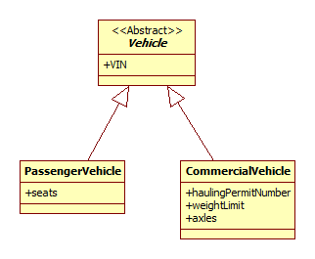
Generalization

Slide 24
Generalization in a Domain Model
A relationship in which specialized sub classes are derived from a generalized super class.
The super class defines everything that is similar (general), while each sub class defines what is specific to itself.
The generalization/specialization relationship is typically implemented in object oriented technology via the inheritance relationship—but since we are in the domain model our classes are concepts not implementable artifacts so the constructs we are modeling are not (yet) inheritance.

Slide 25
Characteristics of a Domain Model
Each specialization “is a” variation of the generalization.
For example if we say Vehicle is the generalization and PassengerVehicle and CommercialVehicle are specializations we have:
  PassengerVehicle “is a” Vehicle; CommercialVehicle “is a” Vehicle. All specializations are in a “is a” relationship with the generalization.
Each sub class carries all of the attributes and associations of the super class.

Slide 26
When to use a Generalization Relationship
Potential sub classes are in a “is a” relationship with the super class
Potential sub classes share an attribute and/or association that can be generalized to a super class
Reduce repetition of information

Slide 27
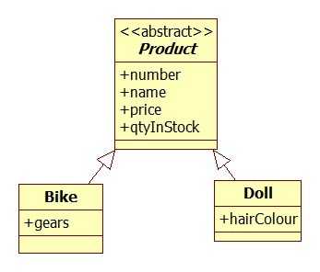
Generalization
when multiple classes share certain properties, they may be “grouped” into a conceptual hierarchy
a superclass represents the general concept
subclasses represent specializations of the superclass
the superclass is deemed to be abstract, if it can not be created in your conceptual model

Slide 28
Example: Bank Accounts
Interest Chequing Account
No Interest Chequing Account
High Yield Savings Account
Business Chequing Account
Tax Free Savings Account
Bonus Savings account

Slide 29
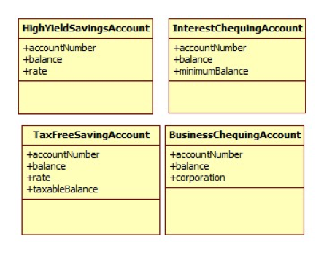
Potential Class Diagram
Common Attributes

Slide 30
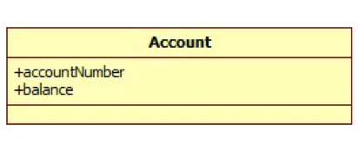
Generalization
conceptual superclass
All these different accounts can be seen as variations of some “general” account…

Slide 31
Generalization in UML
generalization symbol

Slide 32
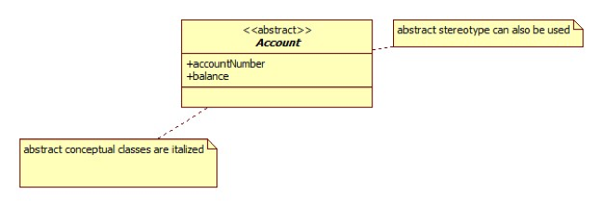
Abstract Conceptual Class
All objects must be a member of a subclass—there will be no instantiation of an Account object.
Notes:
in our example, it is impossible for an “Account” object to exist. ….Only “Savings Account”, “Tax Free Savings” objects can.
“Account” here is used to help classify objects with commonalities

Slide 33
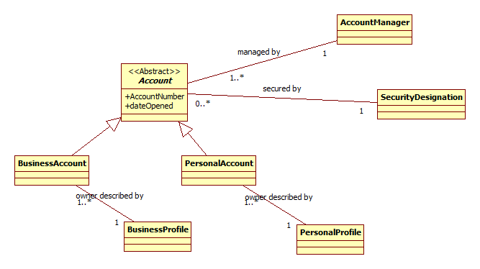
A Different Account Example: Relationships
In a generalization, classes take on the relationships of the base class.
Every specialization of the Account object has to be associated with one AccountManager object and one SecurityDesignation object.
BusinessAccount objects are also associated with a BusinessProfile object
PersonalAccount objects are also associated with a PersonalProfile object

Slide 34
Exercise 4: Find and draw the generalization
A Customer can place an order for either a custom or stock (ready made) window. Each window is considered a separate order. Custom windows have custom sizes which require a description of sizing, glass, etc. and stock windows have stock sizes.

Slide 35
Exercise 5: Find and draw the generalization
The diagram below describes a system to manage both contract and salaried employee pay rates. Redraw using a generalization.

Slide 36
Exercise 6: Find and draw the generalization
Redraw the following diagram using a generalization relationship

